Slide 1


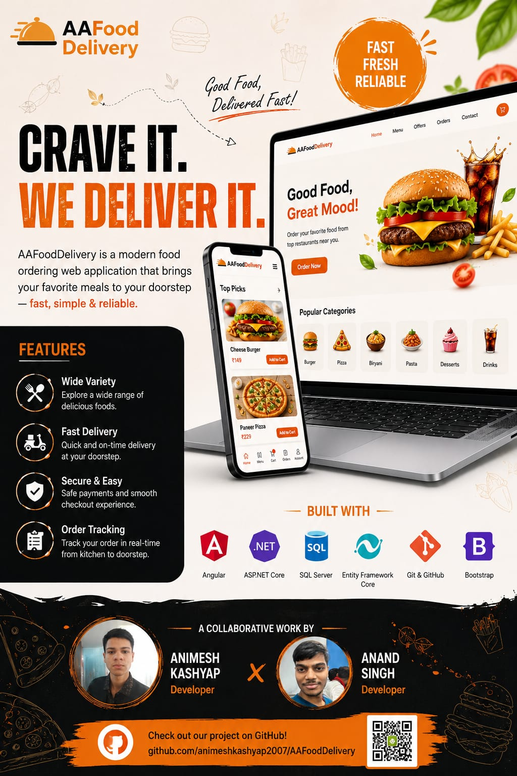
A&A Food Delivery
A Full-Stack Food Ordering & Delivery Web Application
Presented by: Animesh Kashyap - 03013702025
Anand Singh - 01613702025
BCA Student
BCA III M1 Institute of Information Technology & Management (IITM), Janakpuri

Slide 2
Agenda
•
Introduction & Problem Statement
•
Module Walkthrough
•
Objectives
•
Screenshots
•
Features
•
Security (JWT Authentication)
•
Technology Stack
•
Installation & Setup
•
System Architecture
•
Future Scope
•
Database Design (ER Diagram)
•
Project Submission Checklist
•
Workflow / Flowchart
•
Conclusion

Slide 3


Introduction & Problem Statement
The Problem
The Solution
•
Ordering food online today is fragmented across multiple apps.
•
A single, fast, full-stack web platform for browsing menus and ordering.
•
Existing solutions often have inconsistent tracking and slow checkout.
•
Provides seamless real-time tracking for food delivery.
•
Small restaurants often lack an affordable, dedicated ordering platform.
•
Built end-to-end as a BCA final project to demonstrate full-stack skills.

Slide 4
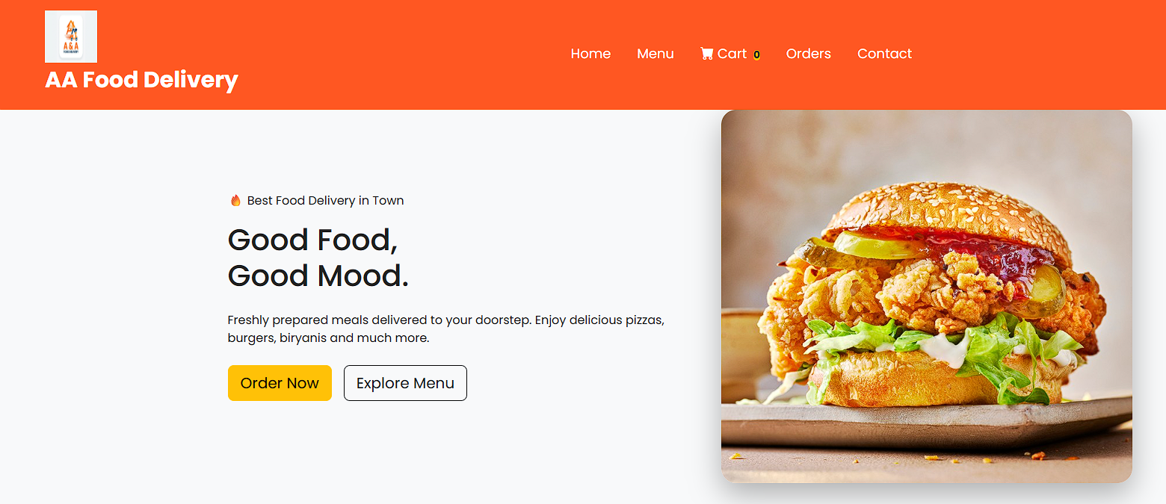


Project Objectives
•
Build a responsive, user-friendly food ordering platform.
•
Implement secure authentication and role-based access.
•
Provide real-time order tracking for customers.
•
Design a scalable backend using Clean Architecture principles.
•
Demonstrate practical use of Angular, ASP.NET Core, and SQL Server together.

Slide 5
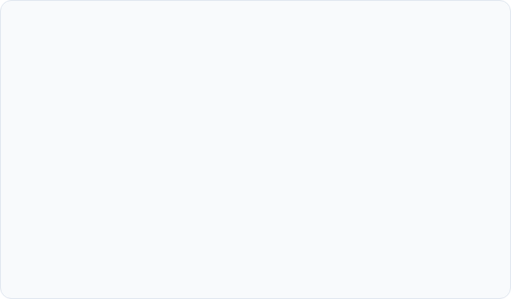

Key Features
•
Home Page with featured food items
•
PDF Invoice Download
•
Food Menu with browsing and search
•
User Login & Registration
•
Shopping Cart with server-side price calculation
•
Real-time Order Tracking
•
Secure Checkout process
•
Contact Page
•
Order History for users
•
Fully Responsive Design (mobile + desktop)

Slide 6






Technology Stack
Frontend
Backend & DB
Tools & Security
•
Angular & TypeScript
•
ASP.NET Core Web API (C#)
•
JWT Authentication
•
HTML5 & CSS3
•
Entity Framework Core
•
Visual Studio 2022 & VS Code
•
Bootstrap
•
Microsoft SQL Server
•
Swagger, Git & GitHub
•
Leaflet (Maps)

Slide 7
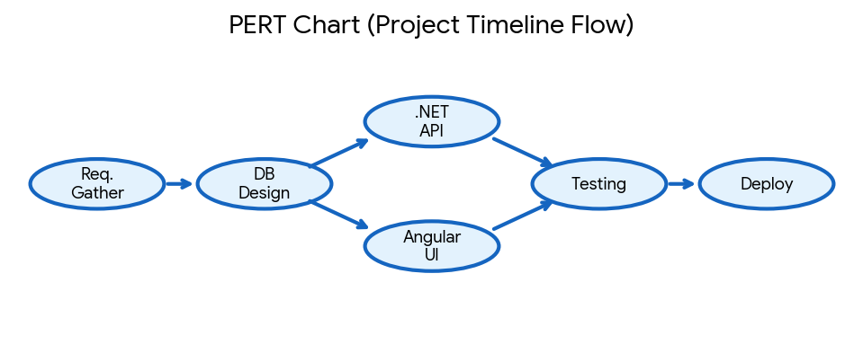
System Architecture
•
Three-tier Clean Architecture: Core, Infrastructure, and API layers on the backend.
•
Frontend: Angular standalone-component architecture communicating via REST API.
•
Database: SQL Server database accessed securely through Entity Framework Core.
•
Authentication: JWT-based stateless authentication between client and server.

Slide 8
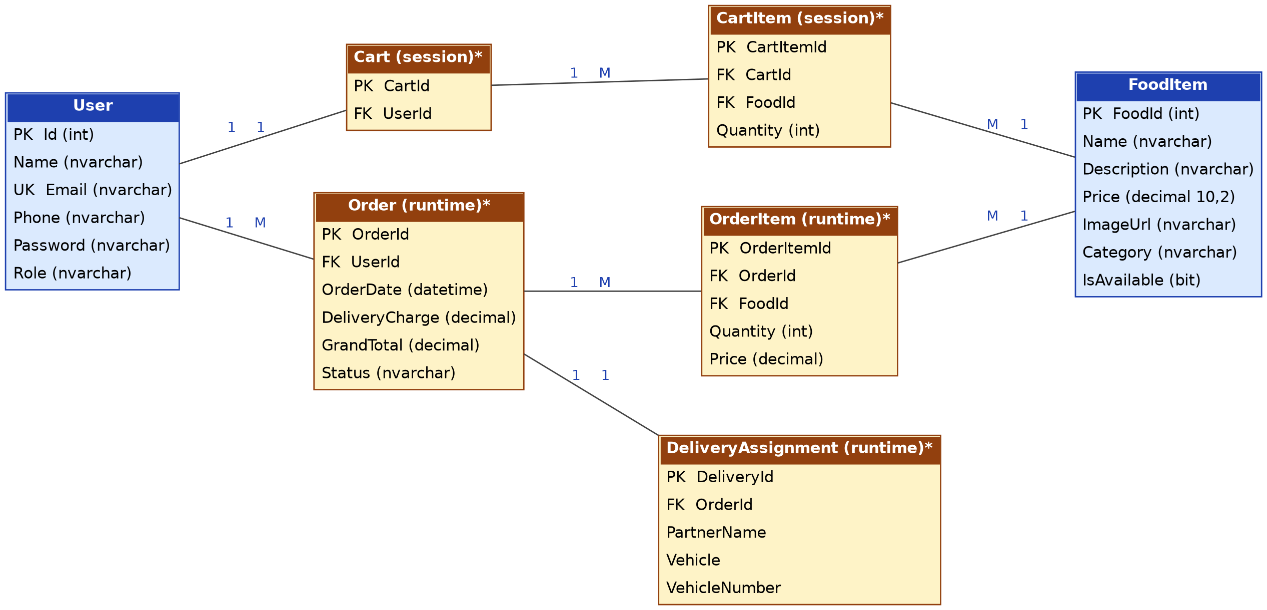
Database Design (ER Diagram)
Core Entities: User, FoodItem, Order, OrderItem, and Cart,Delivery.
•
Relationships: One user can place many orders; each order contains multiple food items.
•
Management: Database schema and versioning managed using Entity Framework Core migrations.
•

Slide 9
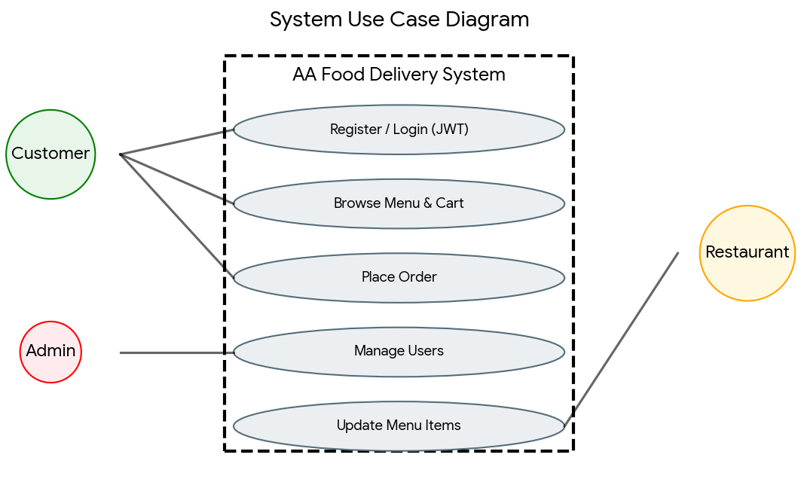
Application Workflow
•
User registers or logs in → JWT token issued.
•
User browses menu → adds items to cart.
•
Cart reviewed → checkout initiated → order placed.
•
Order stored in database → status updates in real time.
•
User downloads PDF invoice and actively tracks order.

Slide 10


Module Walkthrough
•
Authentication Module: Handles user registration, login, and secure JWT token generation.
•
Order Tracking Module: Provides live order status updates directly to the customer.
•
Menu Module: Responsible for food listings, dynamic categories, and detailed item views.
•
Admin Module: Dedicated secure portal to manage food items, categories, and customer orders.
•
Cart & Checkout Module: Manages adding/removing items, real-time price calculation, and order placement.

Slide 11
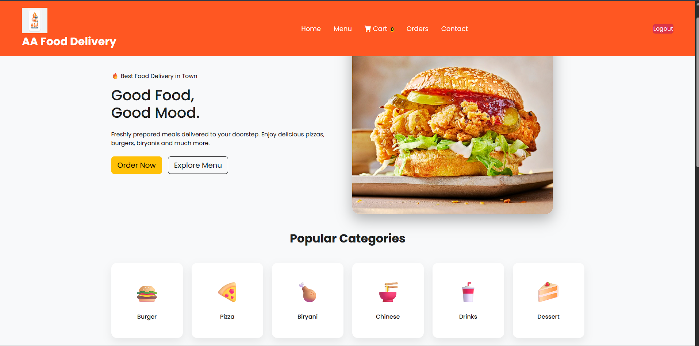
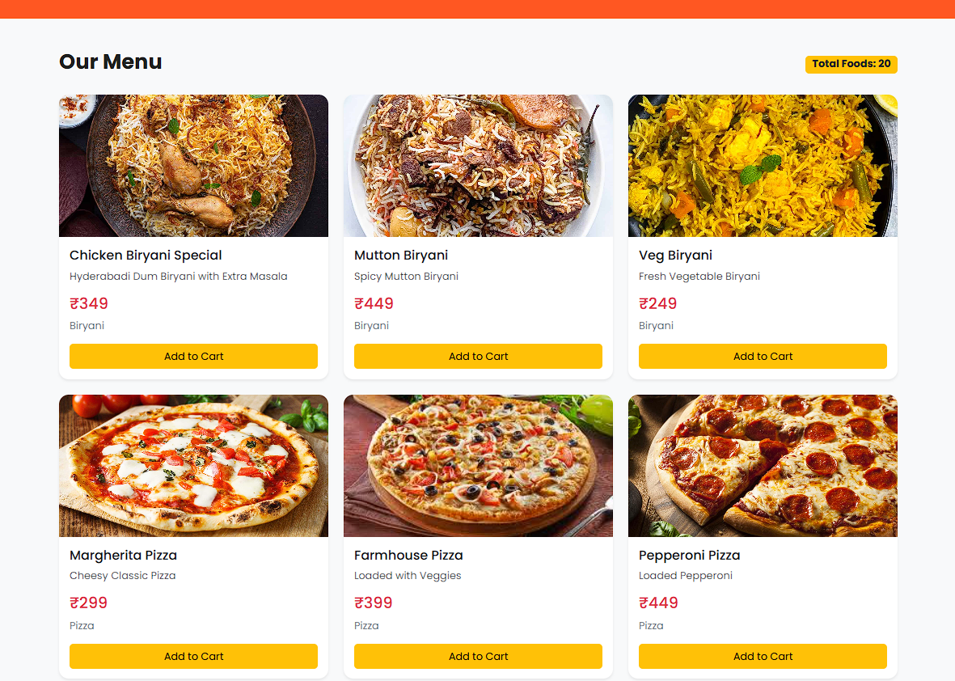

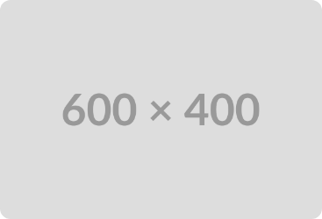
Application Screenshots
Home Page
Menu Page

Slide 12
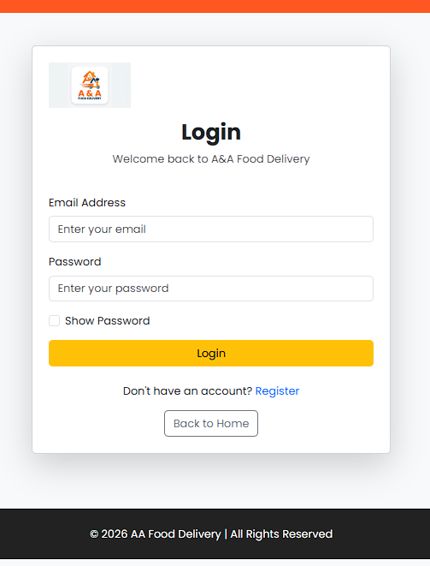
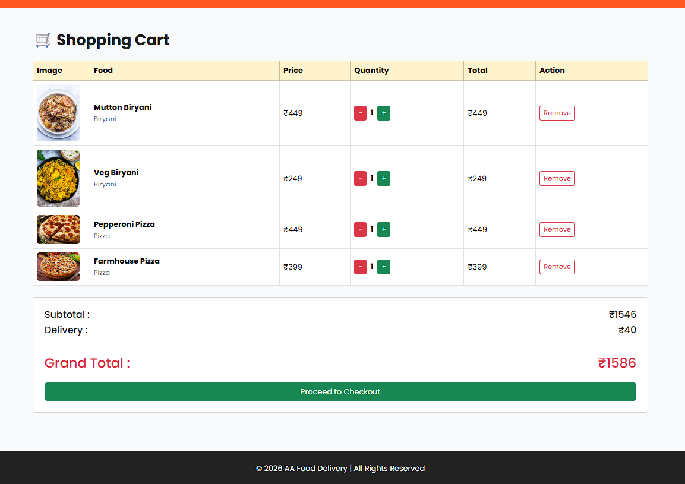
Application Screenshots
Login Page
Cart

Slide 13
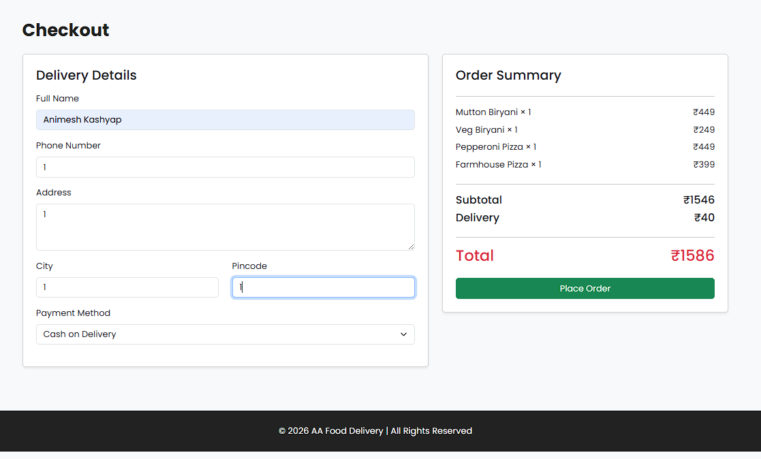
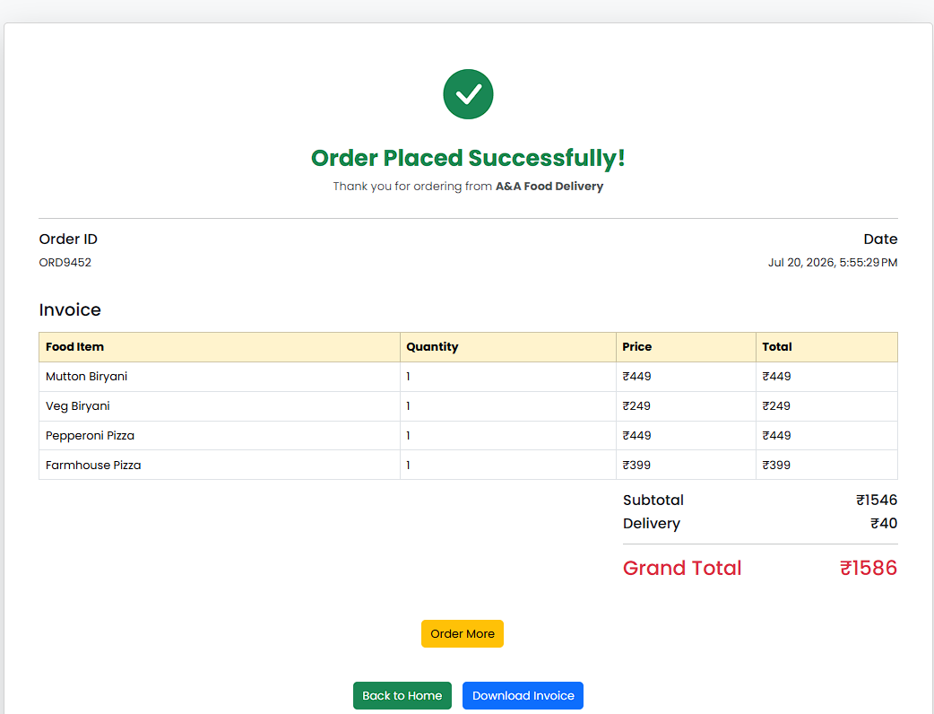
Application Screenshots
Checkout Page
Order Placed

Slide 14
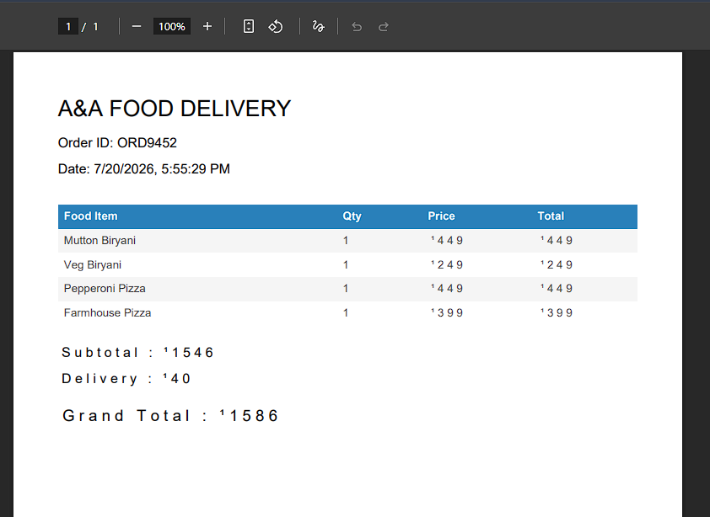
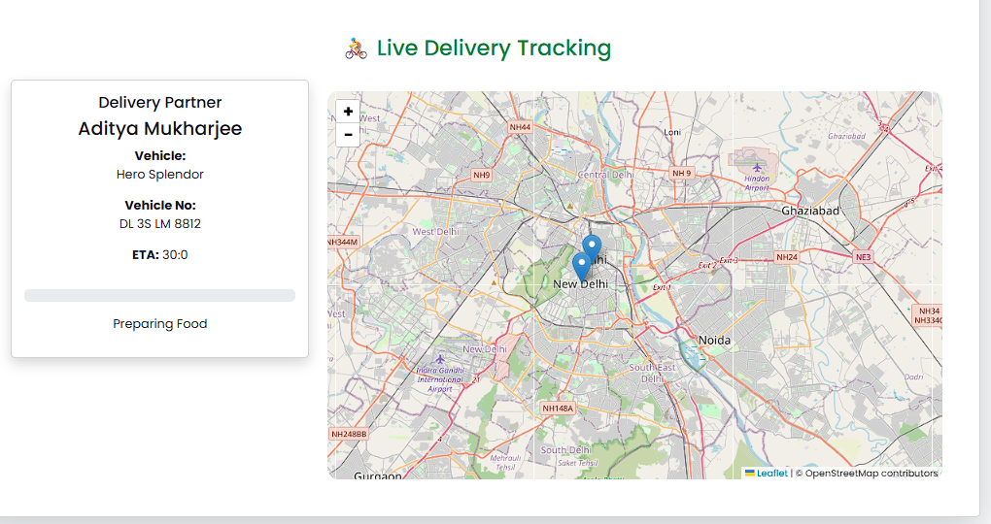
Application Screenshots
Invoice
Tracking Order

Slide 15


Installation & Setup
Backend Setup
Frontend Setup & Requirements
•
Open AAFoodDelivery.API in Visual Studio 2022.
•
Navigate: cd AAFoodDelivery.Client
•
Run: npm install followed by ng serve
•
Restore NuGet packages and update connection strings.
•
Access the application at http://localhost:4200
•
Run the project → Swagger interface opens automatically.
•
Requires: SQL Server instance, Node.js, and .NET SDK.

Slide 16



Future Scope
Expansion
Payments
Smart Features
•
Restaurant partner dashboard for multi-restaurant support.
•
Seamless payment gateway integration (e.g., Razorpay or Stripe).
•
Automated push notifications for order status updates.
•
Delivery rider application with live GPS tracking capabilities.
•
AI-based personalized food recommendations based on history.

Slide 17
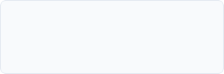
Thank You!
A&A Food Delivery successfully demonstrates a complete full-stack development cycle from database to deployment.
Developed by:
Animesh Kashyap
Anand Singh
LinkedIn:
GitHub Repository:
Anand Singh-
https://www.linkedin.com/in/anand-singh-8646b6383/
Animesh Kashyap -http://www.linkedin.com/in/animesh-kashyap-14b854340
https://github.com/animeshkashyap2007/AAFoodDelivery.git

